Slide 1
An Efficient Algorithm for Determining Protein Structure Similarity
Student: Yu-Chieh Lo (羅裕傑)
Advisor: Chang-Biau Yang (楊昌彪)

Slide 2
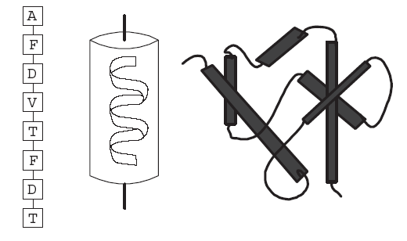
Introduction
If one kind of protein malfunctions in the body, it will cause the physical problem. (e.g. sicklemia)
The structure of protein can be divided into bone structure and side chain structure.

Slide 3
Introduction
The protein structure is related to its function.
However, protein structures need to be confirmed through long experiments (X-ray Crystallography and NMR).
Therefore, there are many scientists who present algorithms to predict the 3D structure of protein through computers.
How would we know if the predicted protein is correct or not ?

Slide 4
Sequence Alignment
When a protein is unknown, one can first determine its sequence by sequencing, then predict the tertiary structure by analyzing the sequence.
Sequences with high similarity are likely to have similar structures and functions, which indicates that they may come from the same origin.
Therefore, we can analyze the similarity between sequences based on sequence alignment.

Slide 5
Sequence Alignment
Ex:
two sequences
TAGTCACG
AGACTGTC
TAGTCAC-G--
-AG--ACTGTC
We can use the dynamic programming to find this result.

Slide 6
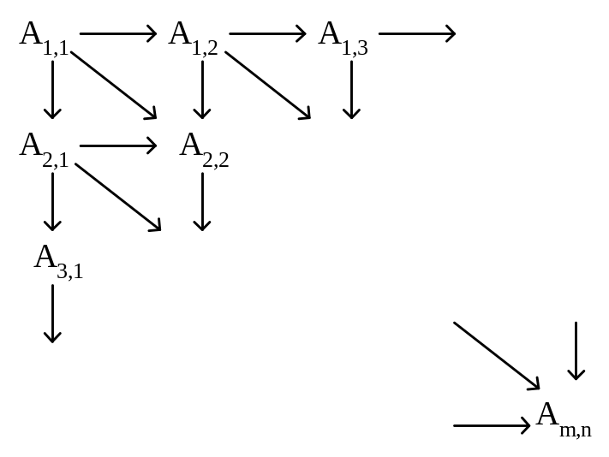
Dynamic programming
S₁ = a₁ a₂ … a_{m} and S₂ = b₁ b₂ … b_{n}
Dynamic programming:
A_{i,j}= A_{i-1,j-1} + 1 if a_{i}= b_{j}
max{ A_{i-1,j}, A_{i,j-1} } if a_{i}≠ b_{j}
A_{0,0} = A_{0,j} = A_{i,0} = 0 for 1≤ i≤ m, 1≤ j≤ n.

Slide 7
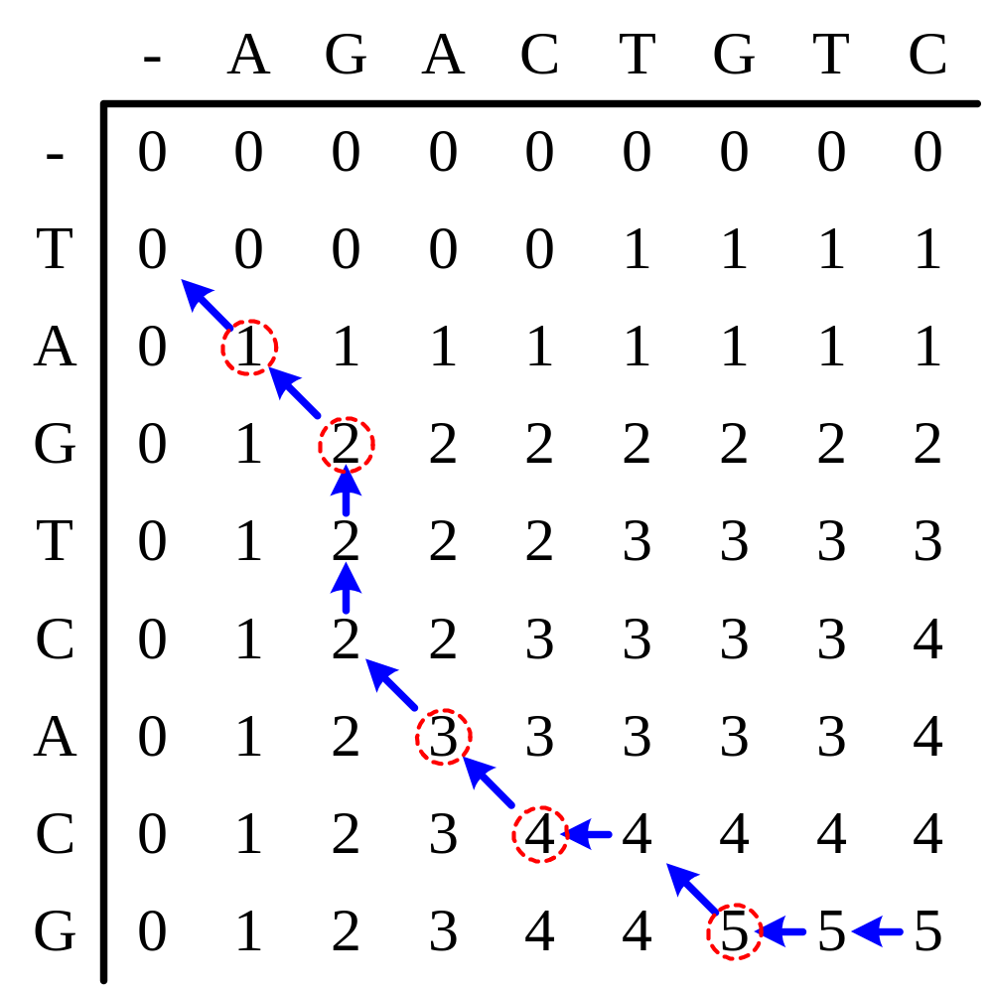
S₂
S₁
TAGTCAC-G--
-AG--ACTGTC

Slide 8

RMSD (Root Mean Square Deviation)
In the latest RCSB, many proteins have the similar structure, but their sequence identity is less than 25 %.
Apparently, to superimpose two proteins is the simplest way to see if they are alike.

Slide 9
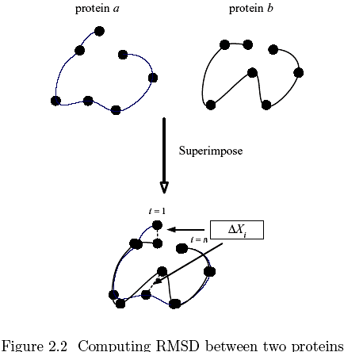
computing RMSD between two proteins

Slide 10
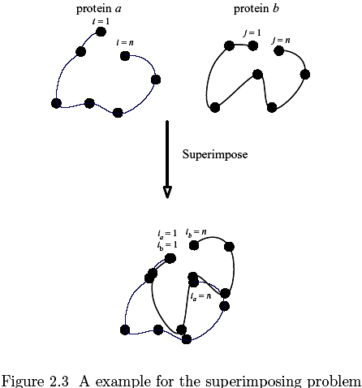
superimposing problem

Slide 11

Distance RMSD
Therefore, the variation of RMSD, called Distance RMSD, uses each pair of the residues in the proteins to compute the distance.

Slide 12

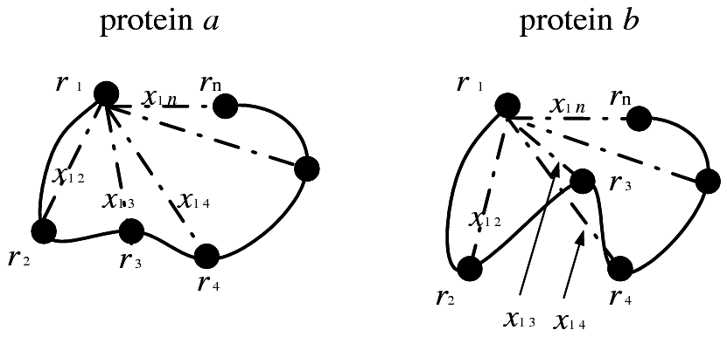
Distance RMSD

Slide 13
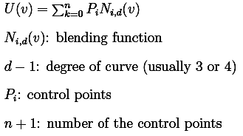
The B-Spline Curve
The B-Spline uses control point which forms an approximate curve.
The function of the B-Spline curve can be written as follows:

Slide 14
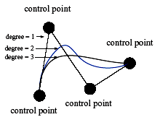
The B-Spline Curve

Slide 15
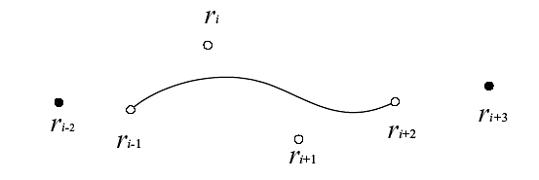
Method
Step 1: Curve Fitting
Note that there is a particular 3D coordinate for each residue, we successively extract four residues from S1 and S2.

Slide 16
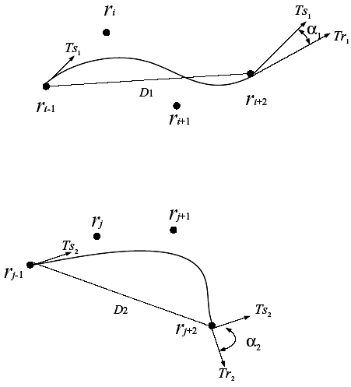

Method
Step 2: Curve Matching
we use scoring function to compute the similarity of these two curves.
Lij denote the match score between the curve for the ith residue in protein S1 and the curve for the jth residue in protein S2.

Slide 17
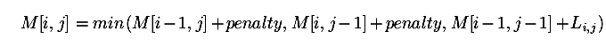
Method
Step 3:
Perform structure alignment based on dynamic programming for each curves formed by the residues of S1 and S2.
Therefore, the formula of the dynamic programming for structure alignment can be written as

Slide 18

Method
Step 4: Normalization
It is not suitable if we directly take M[L1,L2] to be the similarity score of these two proteins.
Therefore, we adopt normalization when computing the similarities.
The formula of normalization can be written as
Similarity score

Slide 19
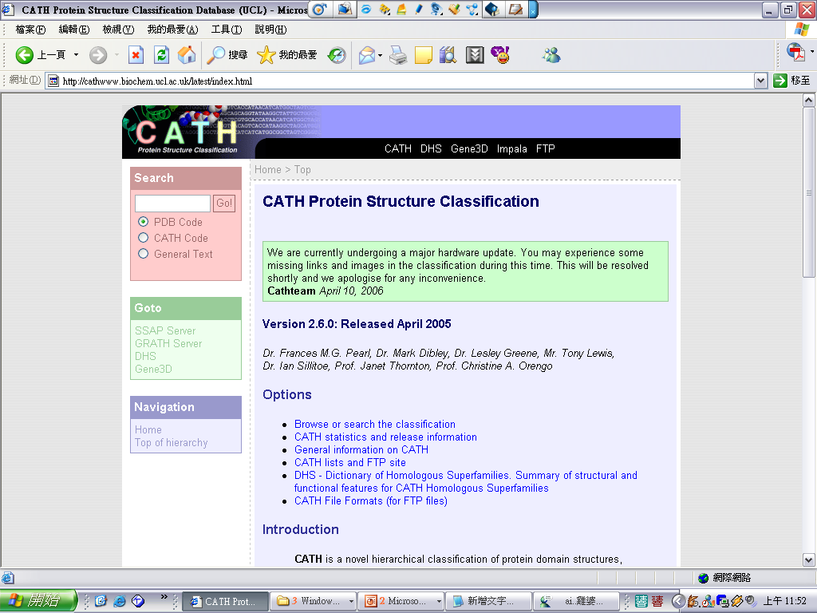
CATH
CATH is a novel hierarchical classification of protein domain structures, which clusters proteins at four major levels, Class(C), Architecture(A), Topology(T) and Homologous superfamily (H).
http://cathwww.biochem.ucl.ac.uk/

Slide 20
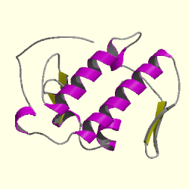
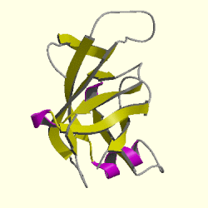
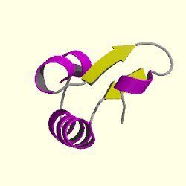
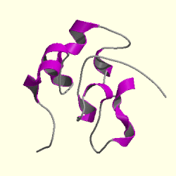
Hierarchy
Class (C-level) : secondary structure composition and contacts
  Class1 : Mainly Alpha
  Class2 : Mainly Beta
  Class3 : Mixed Alpha- Beta
  Class4 : Few Secondary Structures
  Class1 Class2 Class3 Class4
http://cathwww.biochem.ucl.ac.uk/

Slide 21
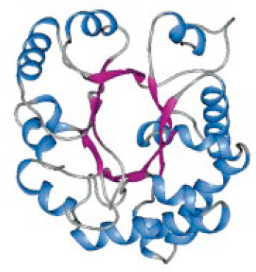
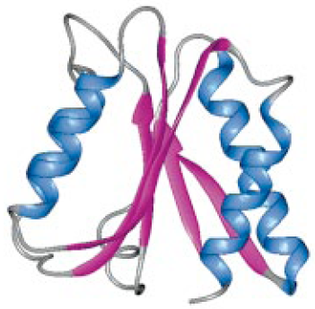
Hierarchy
Architecture (A-level) : description of the gross arrangement of secondary structures, independent of connectivity
  Barrel
  Sandwich
  Barrel Sandwich
http://cathwww.biochem.ucl.ac.uk/

Slide 22
Hierarchy
Topology (T-level) :depending on both the overall shape and connectivity of the secondary structures
  Structures which have a SSAP score
Homologous superfamily (H-level) : highly similar structures and functional similarity
  may have evolved from a common ancestor
http://cathwww.biochem.ucl.ac.uk/

Slide 23
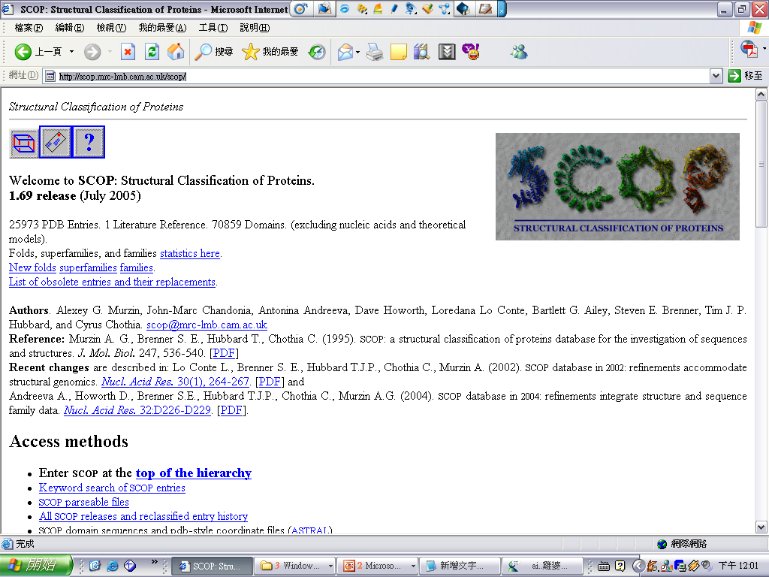
SCOP: A Structural Classification of Proteins Database
http://scop.mrc-lmb.cam.ac.uk/scop/

Slide 24
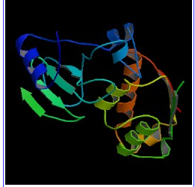
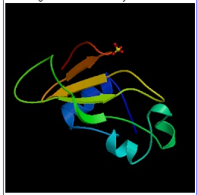
Classification
Class
  all-α：those whose structure is essentially formed by α-helices
  all-β：those whose structure is essentially formed by β -sheets
  α/β ： those with α-helices and β-strands
  α+β：mainly antiparallel beta sheets (segregated alpha and beta regions)
  multi-domain：folds consisting of two or more domains belonging to different classes
http://scop.mrc-lmb.cam.ac.uk/scop/

Slide 25
Classification
Common fold
  Superfamilies and families are defined as having a common fold if their proteins have the same major secondary structures in the same arrangement and with the same topological connections.
Superfamily
  Families whose proteins have low sequence identities but whose structures and, in many cases, functional features suggest that a common evolutionary origin is probable.
Family
  All proteins that have residue identities of 30% and greater.
  The proteins that have lower sequence identities but whose functions and structures are very similar.
http://scop.mrc-lmb.cam.ac.uk/scop/

